Slide 1
Welcome to
Export Bootcamp!

Slide 2
This Training Brought To You By
Special Thanks To Our Supporting Partner
And Welcoming Our Guest Speakers

Slide 3
Erin Butler Director, Commercial Service New Orleans Serving the entire State of Louisiana

Slide 4
Jessica Steverson International Project Manager Louisiana Economic Development

Slide 5
Speakers

Slide 6
Today’s Featured Speakers
John Henry Jackson
CS-New Orleans
Jessica Steverson
La. Economic Development
Winnie Tieu
Fedex
Reggie Harley
Small Business Administration
Saul Newsome
Newsome Int’l Law
Yaye Sarr
Founder, Walo-Med

Slide 7
Why Exports Matter
More than 70% of the world's purchasing power is outside of the United States.

Slide 8
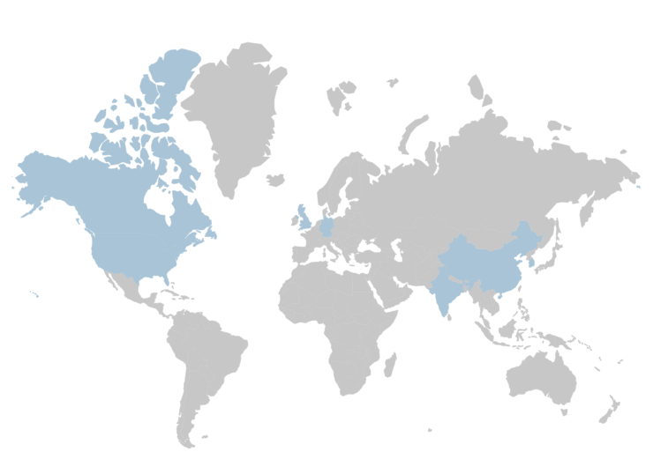
30%
United Kingdom
32%
Canada
With only 12% of our GDP generated by exports…
It’s safe to say we have a lot of room for growth.
20%
China
44%
Korea
12%
United States
20%
India
47%
Germany
Exports of goods & services (% GDP)
Source: WorldBank 2017
Notes:
Competitors are increasing their global market share while the U.S. is underperforming. Export promotion programs in countries around the world have significant funding and staffing to provide assistance and services to their local businesses.
Less than 5% of U.S. SME’s export; and of those that do, 58% sell to just one market.

Slide 9
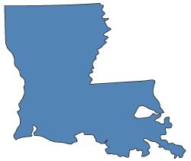
State Impact
Investing in exports means more Louisiana jobs.
155,926 Jobs (2020)
Supported by exports from Louisiana companies in 2020.
2,801 Companies (2019)
In Louisiana sell to customers all over the world.
87 Percent (2019)
Of Louisiana’s exporters are small or medium sized companies.
$76.88 Billion (2021)
Goods exports from Louisiana to the world.
Source: https://www.trade.gov/data-visualization/state-economy-and-trade-factsheets

Slide 10
What’s in it for me?
Diversify your clientele & revenue stream
Beat the competition
Expand your horizons beyond borders
Further leverage competitive advantages

Slide 11
Going Global: Growing Your Business Through Exporting
Notes:
We help our companies compete & win abroad.

Slide 12
Top 5 Steps on Market Entry
Internal Commitment & Capacity
Develop an Export Plan
Conduct Market Research
Strategize Market Entry
Digital & Online Presence
Notes:
There’s no wrong way to enter a market
Some rare cases people can make it without making a single domestic sale or as a one-person company.

Slide 13
Develop a Plan
No Business Plan?
No Export Plan?
Contact your local SBDC
Sample Business Plans
Contact CS New Orleans
Sample Export Plans

Slide 14
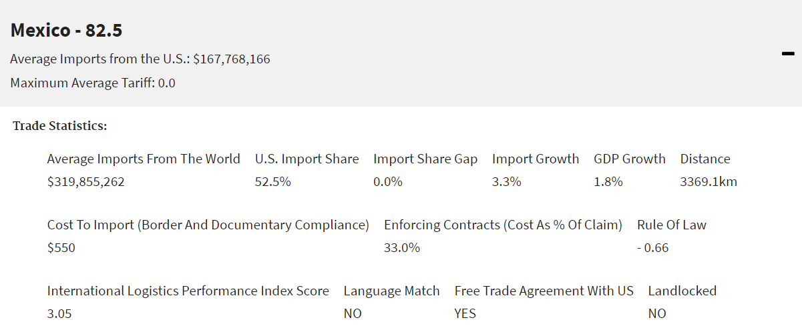
Conduct Market Research
The Commercial Service’s
Market Diversification Tool
Benefits:
Ranks markets based on factors significant to exporting
Countries and weighting can be adjusted
Narrows selection when considering logistics, import, translation and litigation costs.

Slide 15
Commercial Service Market Research Resources
Country Commercial Guides
Industry News
Domestic Trade Events
Your own website traffic & social media footprint + connections
(Get in touch for a quick analysis of your existing website and how to easily make it more appealing to the right kind of foreign buyers.)
Market Diversification Tool

Slide 16
Market Entry – Methods & Channels

Slide 18
1. Who is your customer? 2. Where are they located?

Slide 19
U.S. Free Trade Agreements
Australia
Bahrain
Canada
Chile
Colombia
Costa Rica
Dominican Republic
El Salvador
Guatemala
Honduras
Israel
Jordan
Korea
Mexico
Morocco
Nicaragua
Oman
Panama
Peru
Singapore
Some Benefits Include:
Reduction or elimination of tariffs
Enable greater market access
U.S. input in product standards
Fair treatment of U.S. investors
Stronger intellectual property protection
Boost a company’s bottom line
Notes:
For the United States, the main goal of trade agreements is to reduce barriers to U.S. exports, protect U.S. interests competing abroad, and enhance the rule of law in the FTA partner country or countries.
The U.S. has 14 FTAs with 20 countries which comprise about 40 percent of U.S. goods’ exports. Please note that FTA countries periodically update their rules of origin, which affects tariff schedules. For the latest rules of origin for each FTA and to learn more about FTA benefits for U.S. companies, visit our FTA Help Center. Calculate the tariff rate to export your product to an FTA country using the FTA tariff tool.

Slide 20
Before going overseas, consider Canada
Canada Non-Resident Importer Program (NRI)
Aimed at U.S. companies selling directly to Canadian consumers & companies.
Benefits:
Simplified pricing, no ‘surprise’ fees for you upon arrival
Easy trade process for Canadian customers
Increased competitive advantage
Improves shipment control, consolidated shipments and clearance
Expands market reach into Canada
No charge to establish company as an NRI
Notes:
This program allows the U.S. exporter to include all shipping, customs clearances, duties and taxes in the shipping and handling fees charged to the customer, who could even be charged in Canadian dollars. In this way, the transaction appears to the Canadian consumer as a domestic transaction.
U.S. companies selling directly to Canadian consumers, retailers and businesses.
Do you have an intake process for leads?
Create a price list
Write an introductory sales letter
Create marketing materials
Globalize your website

Slide 21
Market Entry – Methods & Channels
Consider the Following:
Most Common Methods:
Size of your firm
Tolerance of risk
Resources to develop the market
Nature of your products/services
Previous export experience/expertise
Business conditions in the target market
Indirect Selling
Local Partnerships
Direct to Consumer

Slide 22
Market Entry – Indirect Exporting
Indirect = Where a US based company handles the exporting for you
Advantages:
Downsides:
No international experience required
Little to no financial commitment
Taking advantage of large piggyback partner with extensive resources or international presence
Low risk, lower cost to sell internationally
Poor control over sales and marketing decisions
Inadequate market feedback
Lower margin potential
Notes:
Indirect = where a US based company handles the exporting for you
Advantages:
o No international experience required
A company can indirectly export as soon as it has a product to sell that can compete. There is no need to know which foreign markets should be targeted, how to sell to those market, or how to fulfill the order and get paid internationally.
o Management is not distracted
This is particularly important for companies in initial stages of growth where management may devote attention to developing R&D, manufacturing, or sales and marketing strategies while still making the international sale.
o Faster time to international market
By utilizing the experience and strengths of the exporting partner, a company’s product can get to market significantly faster. The company also does not have to have a knowledge of exporting.
o Little to no financial commitment
The export partner typically covers most incremental expenses associated with international sales.
o Low risk
Indirect exporting provides a low risk option for the manufacturer by not creating additional costs in resources and expenses and allowing management to remain focused on developing the business.
Disadvantages:
o Poor control & inadequate feedback
Because all export activities are coordinated by the export partner, this gives a company very little control over the sales and marketing decisions for the export markets involved.
o Inadequate market feedback
In sales that are being managed by a third-party intermediary, customer feedback and information on the market may not be received
o Lower margins
Inevitably, if a company is working with an EMC, a trading company or a larger company in a piggybacking arrangement, lower margins can be expected since their partners will need to be compensated for their efforts.

Slide 23
Market Entry – Finding a Partner
Distributors
How to Find a Partner
They order directly from exporter
Take title of the goods per sales term
Manage inventory for the foreign market
Good for conducting local promotions
Preparing required documents and arranging payment
Clearing goods through customs
Partner Search Services
Attend B2B Matchmaking Events
Virtual & In-Person Trade Shows
Gov’t-Led Missions: TradeWinds
In-Market Company Promotions

Slide 24
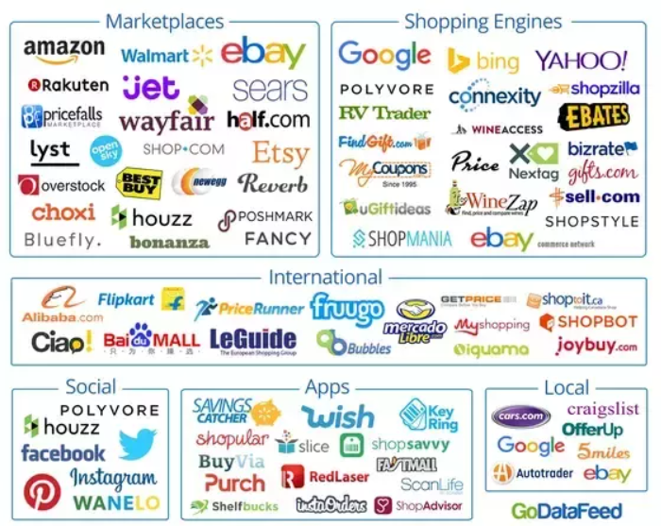
Establishing Online Brand Authority
Market Entry – eCommerce
3rd-Party eCommerce Platforms
Different markets = different platforms
Social media platforms: Facebook(Caribbean), LinkedIn(Canada), Viber(Vietnam)
Your own website – establish KPIs
Company YouTube channel – 2nd largest search engine worldwide
Resources:
ITA eCommerce BSP Service Directory
STEP Grant eligible for any website globalization modifications
Notes:
TaoBao(China), MercadoLibre(Mexico), Coupang(Korea)

Slide 25
Grants & Groups to Support Website Enhancements
CS New Orleans Mini Web Analysis – Free
ITA eCommerce Resource Library
ITA Rural Business Web Gap Analysis Services
MBDA Minority Business & Tech Initiative
SBDC Website Building Counseling – Free
STEP Grant - Will cover 90%
SUSTA (Food & Bev) 50% CostShare

Slide 26
For More Information
John Henry Jackson
International Trade Specialist
504-589-6549
jh.jackson@trade.gov
https://www.linkedin.com/in/johnhjackson/

Slide 27
Trade Finance: Working with Local Lenders & Foreign Buyers
Notes:
We help our companies compete & win abroad.
See slides 2-8 for CS Services overview

Slide 28
International Payment Methods
Cash in Advance
Letters of Credit (LOC)
Private Financing Sources
Open Account

Slide 29
International Payment Methods:
How They Influence Your Financing Needs
Seller Risk
Buyer Risk
High
Low
Open Account
Documentary Collection
Letter of Credit:
(Un)Confirmed &Advised
Cash in Advance
Low
High

Slide 30
How Can I Expand My Foreign Sales?
Offering credit terms makes you more competitive.
Because your customers prefer to use your money rather than theirs.

Slide 31
SAMPLE PRIME LENDING RATES AROUND THE WORLD
Obtaining Credit Locally Can Be Cost-Prohibitive.
Colombia 13%
Mexico 7.5%
Peru 21%
India 12%
Russia 15%
Nigeria 18%
USA 3.25%

Slide 32
BY PURCHASING EXPORT CREDIT INSURANCE!
How Can I Offer Customers Credit Without Taking on This Risk?
Availability
Can be purchased through credit insurers, private brokers, and the U.S. Export-Import Bank.
Coverage
In the event your customer defaults, credit insurance can cover up to 95% of the invoice amount.
Cost
From EXIM Bank
$0.65 on $100 invoice – pay as you go – $100,000 invoice = $650 premium
25% discount offered to SBA customers.
From Private Insurers
$5,000 - $10,000 annual premium

Slide 33
Export Credit Insurance – How Does It Work?
Seller Extends Credit Terms To Buyer
EXPORTER/ SELLER
IMPORTER/BUYER
Seller Transfers Credit Risk
Ongoing Risk Monitoring
INSURANCE COMPANY
IF…
Buyer Fails To Pay Seller
THEN…
Seller Files Claim w/Insurer
AND…
Insurer Pays Seller

Slide 34
What Types of Risk Does Credit Insurance Cover?
Commercial Risks
Insolvency
Bankruptcy
Protracted Default
Political Risks
War, Revolution, Civil Unrest
Expropriation
Currency Transfer Risk
Cancellation of Export/Import Licenses

Slide 35
How Does Credit Insurance Benefit the Exporter?
MARKETING
Allows you to offer your customers competitive payment terms.
FINANCING
Allows you to borrow against your receivables.
PEACE OF MIND
Allows you to sleep at night knowing your risk is covered.

Slide 36
Export Credit Insurance
Export Credit Insurance #1
A lower-cost alternative to LOCs
Foreign A/R Insurance
Protects against non-payment due to country & commercial risks
Coverage Limits
For Country Risk: 85% - 95%
For Commercial risk: 80% - 95%
Export Credit Insurance #2
Insurance Providers
EXIM Bank
Federal Agency
Will do small policies
Has small business mission
Will insure in most countries
Requires majority US content
Limited use for military exports
Private Insurers
Euler Hermes, Atradius, Coface
Offer fast, flexible service
Best for large-scale exporters
Policies become cost competitive @ $3+ million in A/R as it costs ~ $15,000 to sign up.
Export Credit Insurance #3
Insurer underwrites both you & your export sales
Terms can’t exceed 180 days for insurable A/R’s
Many Options Available
Single- vs Multi-buyer policy
Levels of underwriting autonomy & responsibilities can vary.
Deductibles, etc.
Consult an experienced broker to find the best fit for you.

Slide 37
For More Information
Reginald Harley
Export Finance Manager
(202) 906-0217
Reginald.Harley@sba.gov

Slide 38
Logistics: Getting Your Goods From Here To There
Notes:
We help our companies compete & win abroad.
See slides 2-8 for CS Services overview

Slide 39
Agenda
FedEx International Connect
Understanding documentation
Duties & Taxes
HS, HTS, Schedule B numbers
Shipping Methods
Online Tools and Resources

Slide 40
FedEx International Connect Plus benefits you & your customers.
Features and benefits
International day-definite shipping service reaching your online shoppers, typically in 2-5 days*
Offers door-to-door, customs-cleared delivery options
Ideal for single-piece, lower-weight shipments (rates available for shipments up to 150 lbs.)
Shipment is redirected to an alternate location for customers to collect at their convenience if the delivery attempt is unsuccessful (options vary by country)
No residential delivery surcharge
Service is available through latest FedEx automation platforms and many FedEx certified solution providers
Available to over 190 key e-commerce destinations around the world.
How to get started?
1. Work with your sales professional to sign your agreement.
2. Once your rates are activated, our customer technology experts will make sure you’re using the latest FedEx automation solution.
3. After any upgrades, you can start shipping.
* Transit times may vary depending on origin and destination. FedEx International Connect Plus is a contractual service. One delivery attempt is made. Customers need to be Known Shippers and have Electronic Trade Documents enabled in applicable countries.
Notes:
FedEx International Connect Plus provides special rates to ship from over 50 countries to over 190 destination markets.
The FedEx International Shipping Assist tool can help you get started with international shipping.

Slide 41
A step-by-step guide to international shipping
Ensure the Item can be shipped as intended.
Select a customs broker and determine the terms of sale.
Gather important information.
Determine which customs documents are required.
Create an international label.
Complete and submit customs documents.
Package your item.
Get the package to FedEx.

Slide 42
International Documentation
Specific details are required on the international documentation.
Most commonly used
International Air Waybill/Bill of Lading
Commercial Invoice
Shippers Export Declaration
Export License
Certificate of Origin/USMCA Certificate of Origin
Packing Slip
Insurance Certificate
What is their purpose?
The contract between the shipper and the carrier
Main entry document – used by Customs.
US Export Controls – data collected by Census
Validates approval to export - used by Govt.
Establishes true origin of goods - used by Govt.
Identifies contents
Identifies the insurance on the shipment in carriage
Notes:
Refer to page 373 of the Dictionary of International Trade and Page 145 of the Basic Guide to Exporting.
Common Question - Why does the shipment information need to be repeated on a commercial invoice if it’s already included on the Air Waybill?
Note: Required shipment details not included on the documentation is the #1 reason for shipment delays experienced during the customs clearance process.

Slide 43
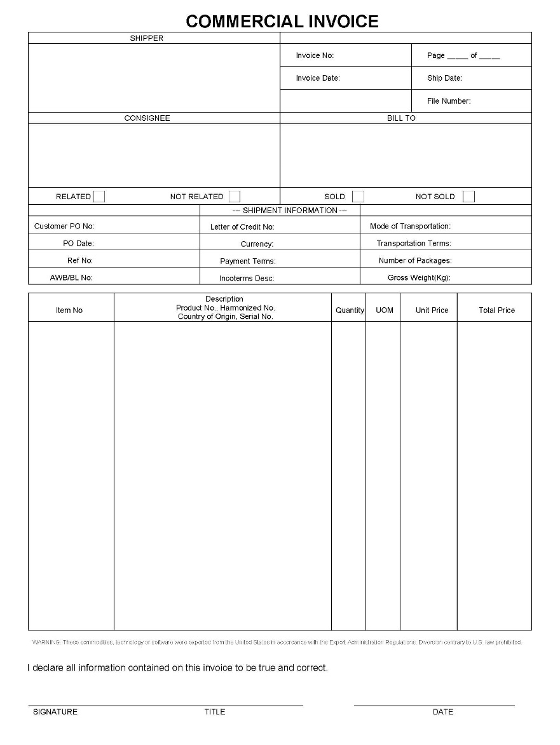
Commercial Invoice
The Commercial Invoice MUST accompany EVERY International shipment.
CI Requirements:
Shipper/Consignee Address
English translation
Full description of the goods
HS code (preferred)
Value for each commodity, adding up to the awb value
Currency type used
Country of origin for each commodity, not a group of countries
Quantity of each item
Total Weight and Number of Packages
Signature
Notes:
The Commercial Invoice is the ONE document that MUST accompany EVERY International shipment.
The Commercial Invoice is a commonly used document for customs clearance. It is a transaction record between the exporter and importer with regards to the goods sold. For FedEx Express shipments- Commercial Invoice paperwork is required for most non-document commodities. The customer must submit one signed original and two copies of the Commercial Invoice. The Commercial Invoice must also accompany the air waybill and should be placed in the pouch with the air waybill.
FedEx International Ground shipments, require three copies of the Commercial Invoice for all shipments to Canada. For multiple –piece shipments to a single recipient, one complete set is needed.
Customers must include the following required information on the commercial invoice: it must be written in English translation, the shipper/co-signee address should be included, a full description of the goods, the harmonized (HS) code, the value of each commodity- which should add up to the awb value, the currency type used, the country of origin for each commodity—not a group of countries, the quantity of each item, the total weight and number of packages, and the customer signature.
If the customer wants to print a Commercial Invoice and complete it by hand, they can download the form for FedEx Ground shipments from U.S. to Canada or download the form for FedEx Express shipment from Global Trade Manager. We will cover GTM later in greater detail.

Slide 44
Electronic Export Information (formerly known as Shipper’s Export Declaration)
The U.S. Census Bureau documents and records export shipments with single commodities valued at $2,500 or more that leave the U.S.
Shippers must file electronically with the U.S. Census
Previously known as the ‘Shippers Export Declaration’
Electronic filing mandatory as of Sept. 1, 2008
Multiple choices are available to enable exporters to meet the requirement
Direct Filer - via U.S. Census site. Registration is required. www.aesdirect.gov
Agent Filing - Contract with a broker to file on behalf of the exporter
Training is available through the U.S. Census Bureau for using their site – AES Direct and through your Vendor for filing via their on-line ‘Agent’ choice.
Do you have the internal resources to learn and self file?
Notes:
Very easy online course to take to become a self filer.
Or you can arrange for an agent to file on your behalf.
Bottom line is that you must file. Carriers need the file number to move the shipment.
This is part of your export compliance responsibilities.

Slide 45
Harmonized System (HS)
The World Customs Organization (WCO) maintains the base 6-digit Harmonized System (HS), which is an international goods classification system for manufacturers, transporters, exporters, importers, customs, and others.
HOW IT WORKS
The HS 6-digit code classifies goods moving in international trade for all participating countries and determines rates of duties and taxes, as well as regulations for particular products. Each country can create a unique classification system by adding up to 4 digits for internal purposes.
The US Harmonized Tariff Schedule (HTS):
Adds 2 digits to distinguish rates and another 2 digits for statistical tracking, creating 10-digit codes
Hs used for imported products. US Schedule B (administered by the US Census Bureau) is used for exported products

Slide 46
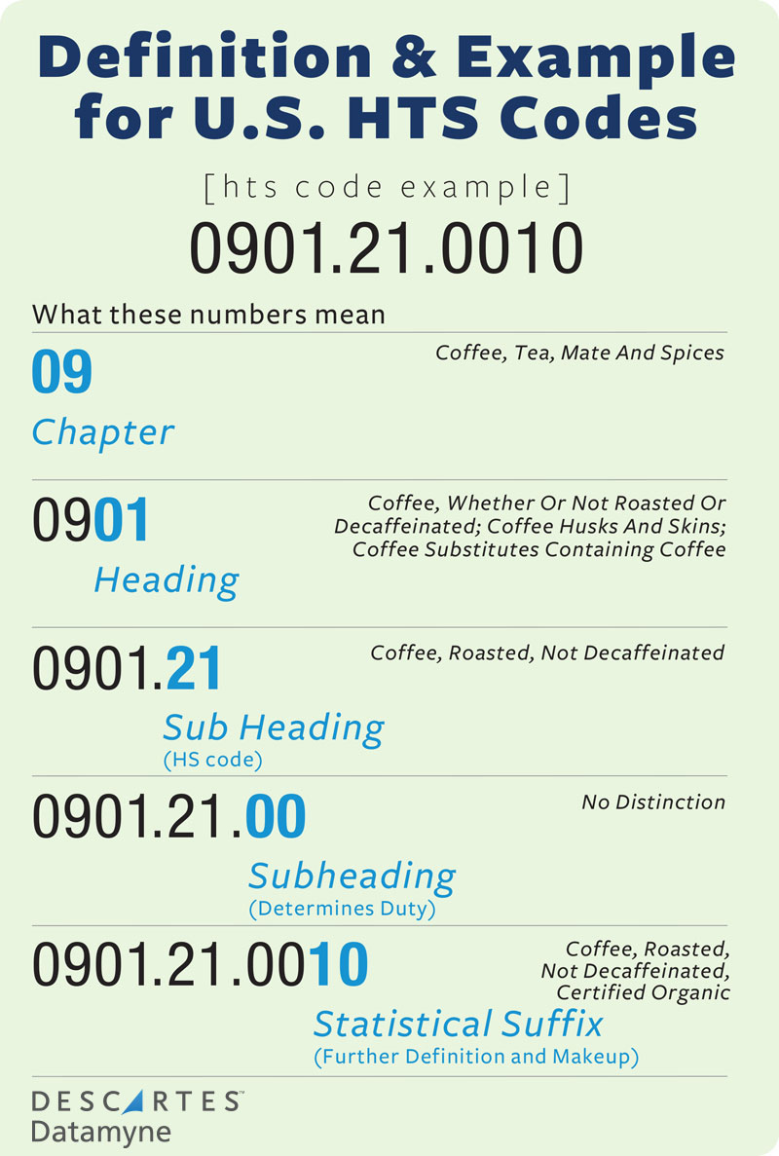

Slide 47
Duties and Taxes
Items entering foreign countries/territories are subject to customs inspections and duties/taxes assessment in accordance with each country's/territory's laws. Customs duties and taxes are assessed if merchandise is valued above the threshold set by each country/territory. FedEx provides international shipment strategy and duty and tax solutions.

Slide 48
Modes of Transportation
Truck/Rail
Station to Station
Door to Door
FTL
Ocean
Port to Port
LTL
Door to Door
Full Container
Partial or Consolidated
Air
Air
Door to Door
Cargo
Full Position
Full Container
Palletized
Multi-Pieces
Multi-Modal
Any combination

Slide 49
Ocean vs. Air vs. Land – How Do You Choose?
Consider the following when choosing the mode of transportation:
Value of product
High
Low
Time required – Speed to market
Need to get there fast
No rush
Competitive environment and new product releases
You want to be first to market
No competition to worry about
Notes:
High value, highly competitive, short shelf life, first to market, strong competitive launch dates = may consider air. Lighter weights cost less, but consider the size also.
Low value, light weight but large is size, low competition, long shelf life, no speed to market concerns, ok to be in transit for 7-14 days = may consider ocean or trucking

Slide 50
Types of Logistics Companies
Integrators and Freight Forwarders – What do they do?
Integrator
Lots of choices
Cost inclusive
Documentation prep and tools, brokerage inclusive
Resource required
Do you have some knowledge and resource?
Forwarder
Customized
Costing based on line item needs
They are your resources
Do you need assistance? No resource?
Notes:
Briefly describe the differences between an Integrated carrier, like FedEx and a Freight Forwarder.
How are they different?
With today’s online tools and resources, one can quickly learn how to do the tasks related to exporting and international shipment processing.
Documentation Prep, Electronic Trade Documents, etc.
If companies have a resources that has some knowledge, or can learn the process, integrator are a good choice.
You know when your shipment will leave and arrive and that the integrator controls possession.
If companies have little to no knowledge, not time to learn, no resources to do the tasks, then a forwarded can be a good choice.
Forwarders do not own their own aircraft, trucks, etc so they purchase space from companies that do …i.e. FedEx purple tails.
Many forwarders consolidate shipments and arrange full container movements to keep the costs down. This impacts the movement schedule.

Slide 51
Tools and Resources
U.S. Commercial Service website
Export.gov – Free
U.S. Census Harmonized Code Lookup
uscensus.prod.3ceonline.com/#/p=0
A Basic Guide to Exporting – 11th Edition
Available online at amazon.com – Approx. $20
Dictionary of International Trade – Approx. $65
Available online at worldtradepress.com/Dictionary_of_International_Trade.php
Incoterms
iccwbo.org/incoterms/

Slide 52
For More Information
Winnie Tieu
Senior Account Executive, International
504-252-5389
winnie.tieu@fedex.com

Slide 53
EXERCISE! FINDING YOUR “SCHEDULE B” #
Notes:
We help our companies compete & win abroad.
See slides 2-8 for CS Services overview

Slide 54
Legal & Compliance Considerations

Slide 55
Domestic Compliance for Exporters
Three U.S. Export-Control Regimes:
Department of State (Office of Defense Trade Controls) controls defense articles, defense services, and related technical data, including most space-related articles.
Department of Commerce (Bureau of Industry and Security) controls all other items, including “dual-use” items – goods and technology with both civilian and military/strategic uses.
Department of the Treasury enforces U.S. sanctions and embargoes (Office of Foreign Assets Control)

Slide 56
Assemble Your International Team
Technical/ Operational Knowledge
Logistics
Accounting / Tax
Sales / Marketing
L E G A L

Slide 57
Legal Structure: The Risk/Reward Opportunity
Allow risk v. reward research to drive the opportunity & structure your international transaction:
Assess the Risks and Reward:
Regulation
Tax
Liability
Price
Plan Accordingly:
Storefront v. Online
Employment v. Contractors
Local Agent v. Distributor
Insurance
Reduce to Contract:
Entity Formation
Sales/Services Agreement
License – Franchise
Allocation of Risk
Joint Venture
Exporting
Strategic Agreements
Wholly- Owned Subsidiary
Licensing/ Franchising
Risk and Control
Notes:
Balance between free and open investment and preserve and sustain and encourage technology and capabilities that ensure strategic interests.
1975 – 1988 Exxon Florio –
Previously, a voluntary process – CFIUS would look at foreign acquirer or nationally interested technology/business – what type of threat – country review? And then target acquisition – the business ?
CFIUS would redesign or implement controls – Or, ultimately recommend to president to block or unwind it.
Broadcom (based in singapore) – acquire Qualcom – Broadcom was (5g techonology) trying to redomesticate to US (worry of chinese intesest)
Genworth – China Oceanwide (protecting US PPI) insurance – protecting of third party control and auditing of
CFIUS expanded jurisdiction Aug 2018

Slide 58
Dispute Resolution and Risks
Consider the legal risk—for your specific business—in the region in which you want to expand:
Favorable or Neutral Governing Law
Internal (contractual) dispute-resolution process
External dispute resolution (arbitration, mediation, exclusive jurisdiction)
Adjudicatory Process and Enforcement Mechanisms
Mitigation Strategy

Slide 59
For More Information
Saul Reinaldo Newsome
Partner
(225) 384-0204
saul@newsome-law.com

Slide 60
LED’s STEP Grant Program: Kickstarting Your Export Journey
Notes:
We help our companies compete & win abroad.
See slides 2-8 for CS Services overview

Slide 61
What’s Eligible?
STEP Grant
State Trade Expansion Program (STEP) Grant for Export Promotion
Who’s Eligible?
Trade show exhibition/booth fees (virtual or in-person)
Trade mission fees (virtual or in-person)
Export training courses & workshops (virtual or in-person)
U.S. Department of Commerce fee services
Travel-related expenses such as airfare, lodging, and meals
Marketing materials and media to promote exports
E-commerce and website fees (internationally-focused)
Cost of compliance testing
Other approved activities and expenses
Meet the SBA definition of a small business
Have been in business for at least one year
Be a for-profit business based in Louisiana
Be new to export or seeking new export markets
Have a plan for exporting (export strategy)
Understand costs associated with exporting
Be an export-ready U.S. company seeking to export goods or services of U.S. origin OR have at least 51% U.S. content
Not be debarred from doing business with the Federal Government
More Info: https://www.opportunitylouisiana.com/small-business/special-programs-for-small-business/step-grant
Notes:
If y’all take anything away from this presentation tonight, it’s the STEP Grant. 90% reimbursement rate on eligible expenses, with a maximum benefit per company of $7,500.

Slide 62
For More Information
Jessica Steverson
International Project Manager
jessica.steverson@la.gov
504-982-2537

Slide 63
The Export Expert Session: Lessons Learned Along the Way
Notes:
We help our companies compete & win abroad.
See slides 2-8 for CS Services overview

Slide 64
For More Information
Yaye Sarr
Founder & CEO
ysarr@walomed.com
504-813-0789

Slide 65
Your Louisiana Export Team
John Henry Jackson
Senior International Trade Specialist
504.313.2061
JH.Jackson@trade.gov
Baton Rouge & Greater New Orleans Areas
Reginald Harley
Trade Finance Specialist
504.589.6685
Reginald.Harley@sba.gov
SBA Office of International Trade
All of Louisiana
Erin Butler
Director
504.264.4826
Erin.Butler@trade.gov
All of Louisiana
Charlotte Conerly
International Trade Specialist
504.259.6792
Charlotte.Conerly@trade.gov
South/Southwest Louisiana

Slide 66
For additional questions, contact us!
U.S. Commercial Service New Orleans
423 Canal St, Suite 419
New Orleans, Louisiana 70130
Office.NewOrleans@trade.gov
Find your local office:
https://www.trade.gov/commercial-services-offices-us
linkedin.com/in/csneworleans
@CSNewOrleans

